Slide 1
CDA Generation and Integration for Health Information Exchange Based on Cloud Computing System

Slide 2
ABSTRACT:
In this paper, we describe our CDA document generation and integration Open API service based on cloud computing, through which hospitals are enabled to conveniently generate CDA documents without having to purchase proprietary software. Our CDA document integration system integrates multiple CDA documents per patient into a single CDA document and physicians and patients can browse the clinical data in chronological order. Our system of CDA document generation and integration is based on cloud computing and the service is offered in Open API. Developers using different platforms thus can use our system to enhance interoperability

Slide 3
EXISTING SYSTEM:
Effective health information exchange needs to be standardized for interoperable health information exchange between hospitals. Especially, clinical document standardization lies at the core of guaranteeing interoperability.
It takes increasing amount of time for the medical personnel as the amount of exchanged CDA document increases because more documents means that data are distributed in different documents. This significantly delays the medical personnel in making decisions. Hence, when all of the CDA documents are integrated into a single document, the medical personnel is empowered to review the patient’s clinical history conveniently in chronological order per clinical section and the follow-up care service can be delivered more effectively.

Slide 4
DISADVANTAGES OF EXISTING SYSTEM:
The HIS development platforms for hospitals vary so greatly that generation of CDA documents in each hospital invariably requires a separate CDA generation system. Also, hospitals are very reluctant to adopt a new system unless it is absolutely necessary for provision of care. As a result, the adoption rate of EHR is very low except for in a few handful countries.
Unfortunately for now, a solution that integrates multiple CDA documents into one does not exist yet to the best of our knowledge and there is a practical limitation for individual hospitals to develop and implement a CDA document integration technology.

Slide 5
PROPOSED SYSTEM:
In this paper we present (1) a CDA document generation system that generates CDA documents on different developing platforms and (2) a CDA document integration system that integrates multiple CDA documents scattered in different hospitals for each patient.
CDA Generation API generates CDA documents on cloud.
CDA Generation Interface uses the API provided by the cloud and relays the input data and receives
CDA documents generated in the cloud.
Template Manager is responsible for managing the CDA documents generated in the cloud server. Our system uses CCD document templates.

Slide 6
ADVANTAGES OF PROPOSED SYSTEM:
Hospital systems can simply extend their existing system rather than completely replacing it with a new system. Second, it becomes unnecessary for hospitals to train their personnel to generate, integrate, and view standard-compliant CDA documents.
The cloud CDA generation service produces documents in the CDA format approved by the National Institute of Standards and Technology (NIST).
If this service is provided for free at low price to hospitals, existing EHR are more likely to consider adoption of CDA in their practices.

Slide 7
SYSTEM ARCHITECTURE:

Slide 8
HARDWARE REQUIREMENTS:
System : Pentium Dual Core.
Hard Disk : 120 GB.
Monitor : 15’’ LED
Input Devices : Keyboard, Mouse
Ram : 1GB.

Slide 9
SOFTWARE REQUIREMENTS:
Operating system : Windows 7.
Coding Language : JAVA/J2EE
Tool : Netbeans 7.2.1
Database : MYSQL

Slide 10
MODULES:
Construction of System Environment
The CDA Document
Construction of a Cloud Computing Environment
Integration of CDA Documents via Our Cloud Server

Slide 11
Construction of System Environment
In the first module we develop the Construction of the System Environment to prove our proposed system model. In this module we develop Hospital A, Hospital B, Doctor, Patient/User, Admin and Cloud Modules.
In Hospital A, we create the User Authorization with Login Credentials. This module provides the option of Upload the Patient details as XML File in the Cloud with Encrypted and also provides the option to check the status of the uploaded file with the XML Format. The same is followed in the Hospital B too.

Slide 12
The CDA Document
In this module we develop the CDA document. The HL7 Clinical Document Architecture Release 2 (CDA R2) was approved by American Nation Standards Institute. It is an XML-based document markup standard that specifies the structure and semantics of clinical documents, and its primary purpose is facilitating clinical document exchanges between heterogeneous software systems.
A CDA document is divided into its header and body. The header has a clearly defined structure and it includes information about the patient, hospital, physician, etc. The body is more flexible than the header and contains various clinical data.

Slide 13
Construction of a Cloud Computing Environment
In this module we develop the Cloud computing environment. We use DriveHQ Cloud Service provider to upload our files in the Cloud.
In this module, we develop the construction of a Cloud Computing Environment and how multiple CDA documents are integrated into one in our CDA Document Integration System. The standard for this is Korean Standard for CDA Referral and Reply Letters (Preliminary Version). Templates which generate a CDA use CCD part of Consolidated CDA which is released by ONC and made by HL7. However, an actually generated CDA has a form of CDA Referral and Reply Letters.

Slide 14
Integration of CDA Documents via Our Cloud Server
We integrated multiple CDA documents of patient referrals and replies by using the API at our server. The use case scenario and patient data used for integration are shown in this module.
We adopted sample patient data provided by the US EHR Certification Program, Meaningful Use. The data does not pertain to an actual person. It is fictional, and available for public access. This module is to show how a client integrating multiple CDA documents by using our API. The sample many clinical documents are shown to be successfully integrated.

Slide 15
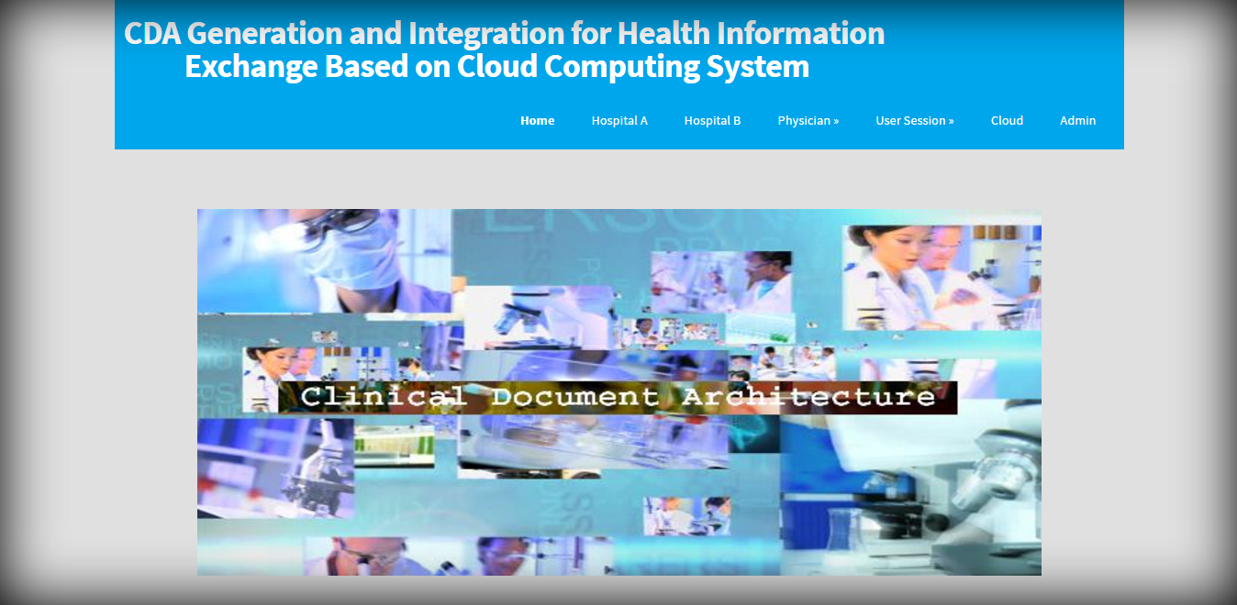

Slide 16
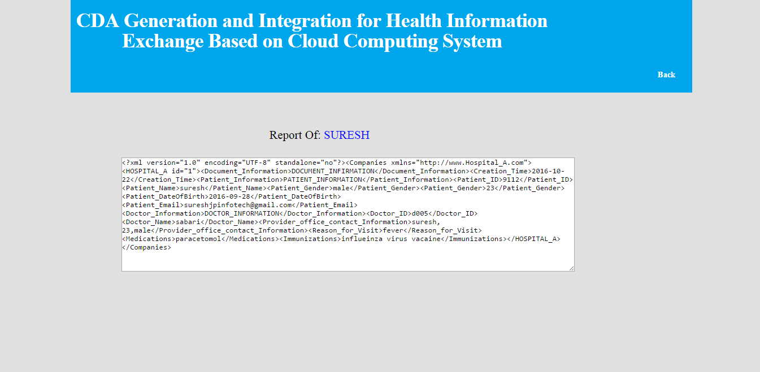

Slide 17
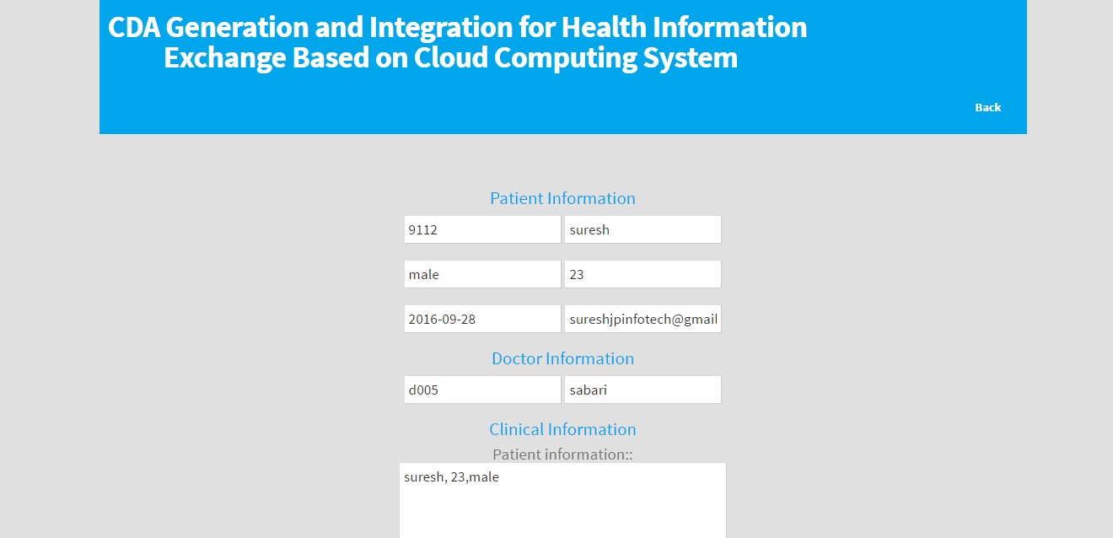

Slide 18
REFERENCE:
Sung-Hyun Lee, Joon Hyun Song, and Il Kon Kim, “CDA Generation and Integration for Health Information Exchange Based on Cloud Computing System”, IEEE TRANSACTIONS ON SERVICES COMPUTING, VOL. 9, NO. 2, MARCH/APRIL 2016.

